Slide 3
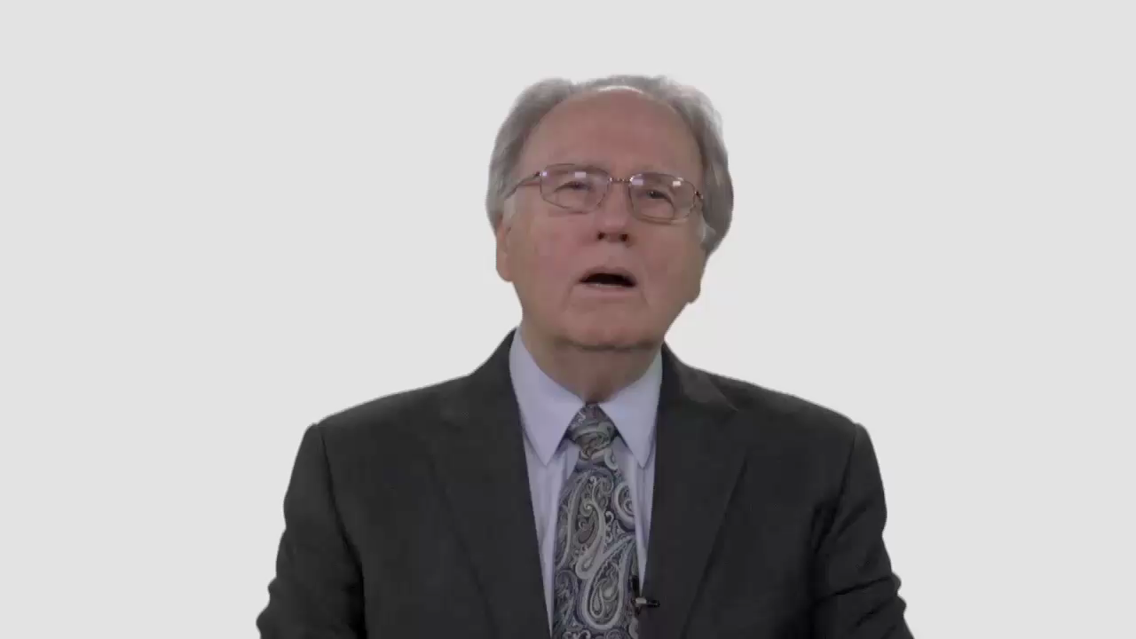

Slide 4
Have Your Say.
How do you respond to the
suggestion that political involvement
is a distraction that draws time and energy away from our true mission?

Slide 5
Conversation Builders.
Because our citizenship lies
elsewhere, should we keep our distance from the political concerns
of our community or nation?

Slide 6
Conversation Builders.
Should Adventists be
concerned about leaving
national policy to unbelievers?

Slide 7
Discussion Questions.
Imagine the day-to-day life
of an Adventist politician. In
what ways would his or her
principles be tested?

Slide 8
Discussion Questions.
Do Adventist values and beliefs
have anything significant to contribute to current political debates?

Slide 9
Discussion Questions.
Can you think of any public
policy issues in today’s headlines where an Adventist perspective
could be valuable?

Slide 10
What Now?
Does our church clearly explain to young people the difference between healthy civic participation and unhealthy political partisanship?

Slide 11
What Now?
Could your local congregation do
more to provide such guidance
without stepping into the
realm of partisan politics?

